Slide 1
CSE 299 Final Presentation
Faculty: DR. MAHDY RAHMAN CHOWDHURY (MDY)
Section: 01
Group: 06
1. MD Sohanur Rahman Sohan 2022389642
2. MD Sadikur Rahman Sadeed 2112251642
3. Silvia Salim 1530712042

Slide 2
Topic
Predicting the Stock Price of Frontier Markets Using Modified Black-Scholes Option Pricing Model and Machine Learning

Slide 3
Option Pricing Model
Option pricing was first started at the beginning of the twentieth century by Louis Bachelier.
In 1960s, significant progress had been made on valuation of option pricing, which were reflected on the great works done by some financial economists.
The term "option pricing model" refers to a mathematical framework or formula used to calculate the theoretical price of an option.

Slide 4
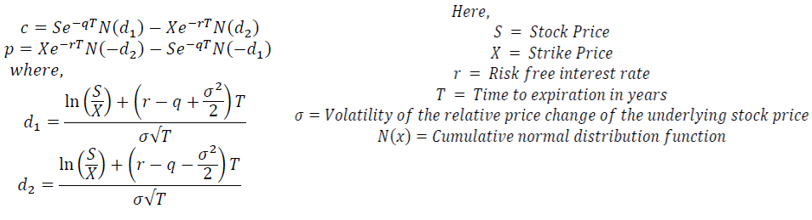
BSOPM
One of the most basic and powerful tools in financial mathematics is the Black-Scholes equation, which is used to find the prices of assets.
The Black-Scholes option pricing model is specifically designed for European-style options, which can only be exercised at expiration.

Slide 5
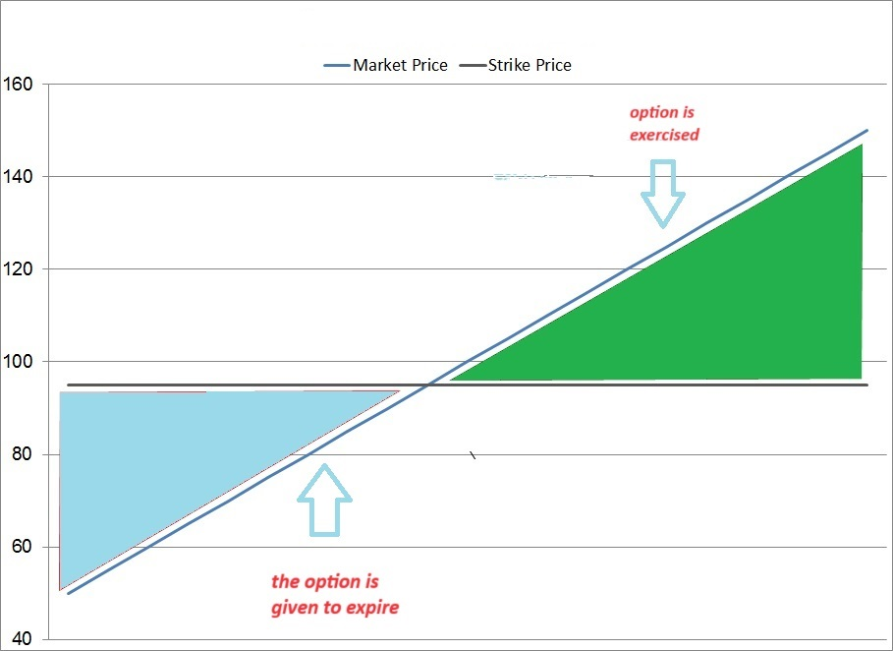
Option Pricing Model
Developments of option pricing model, it has now became easier to trade options and so option pricing is no longer viewed as esoteric financial instrument .

Slide 6
Option Pricing Model
Option Pricing Model
Call Option
Put Option

Slide 7
Call Option

Slide 8
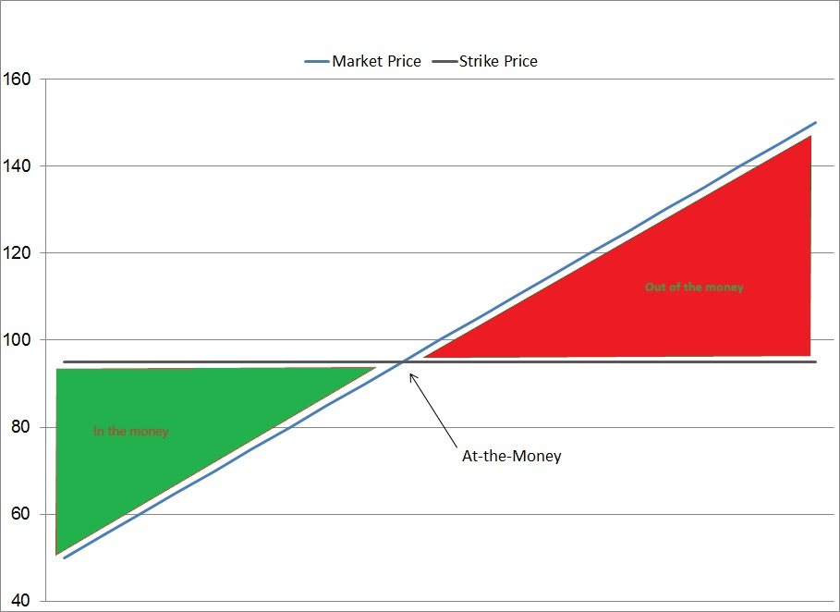
Put Option

Slide 9
Stock price prediction of a particular company of frontier markets using Black-Scholes formula have not been studied so far.
The reason is that BSOPM has parameters called strike price and time to maturity and volatility, which do not even exist when it comes to trading in frontier markets.
Machine learning and data mining play a very important role, when it comes to predicting stock prices of both frontier and derivative markets.

Slide 10
It is because algorithms can be trained and developed by using machine learning so that it can almost accurately predict the future stock prices based on historical prices of the stocks and can also display the results through prediction and description.

Slide 11


Slide 12


Slide 13
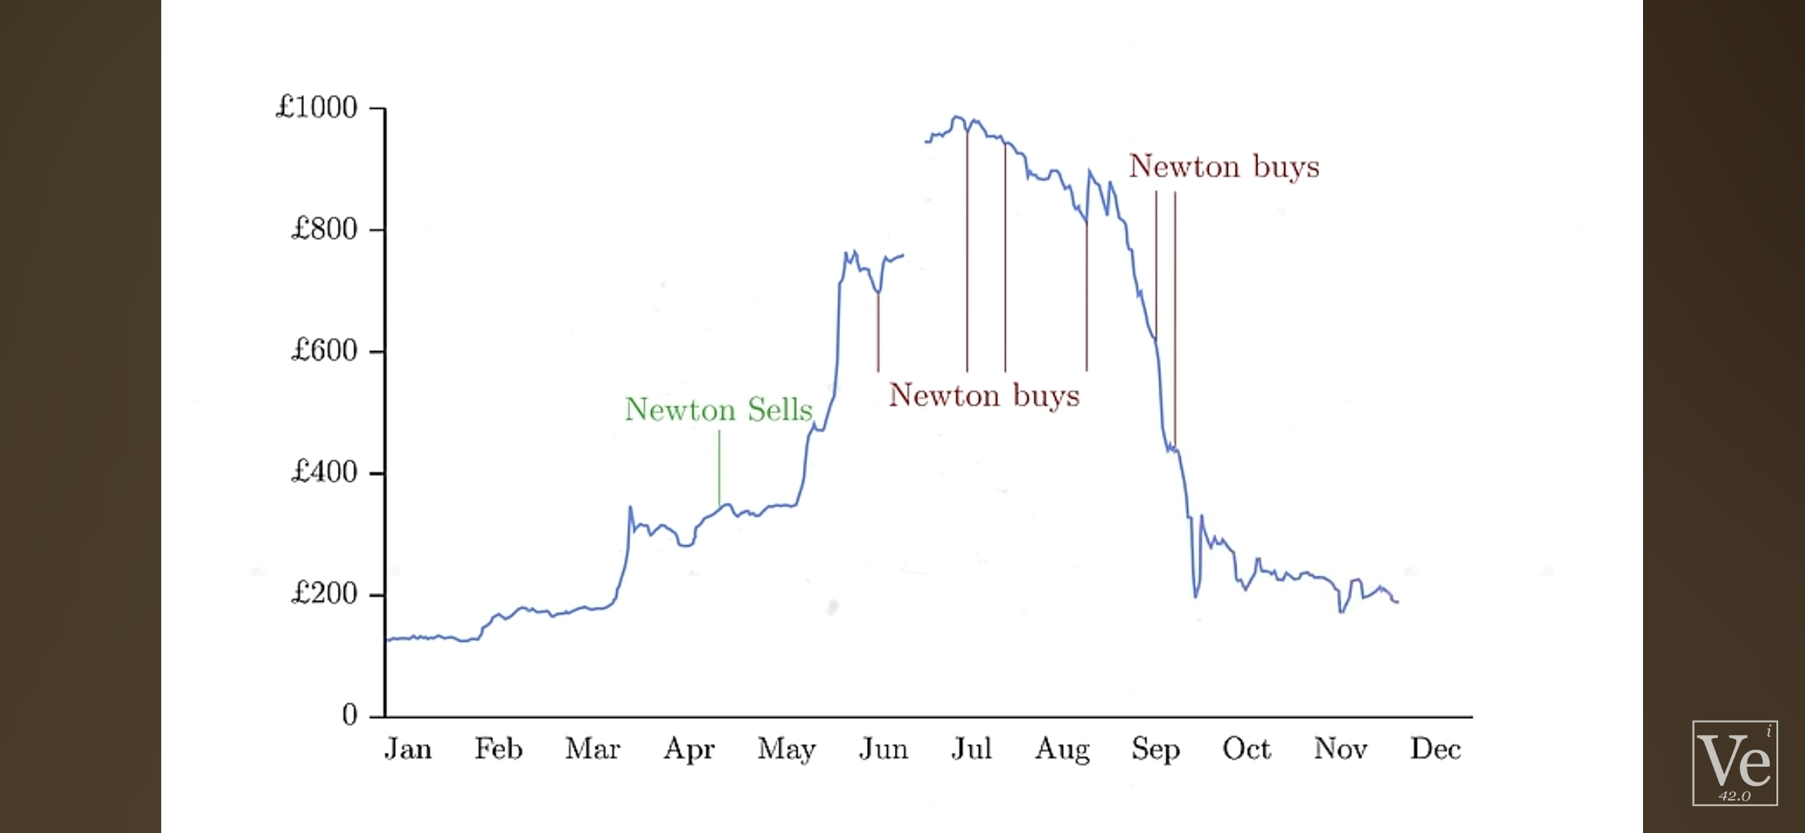

Slide 14


Slide 15


Slide 16


Slide 17
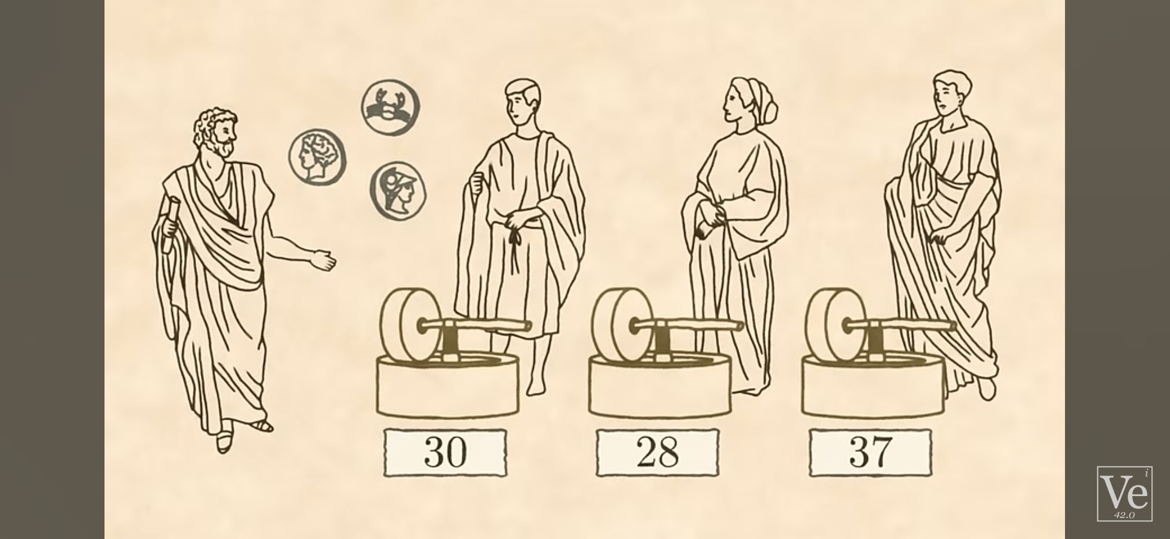

Slide 18
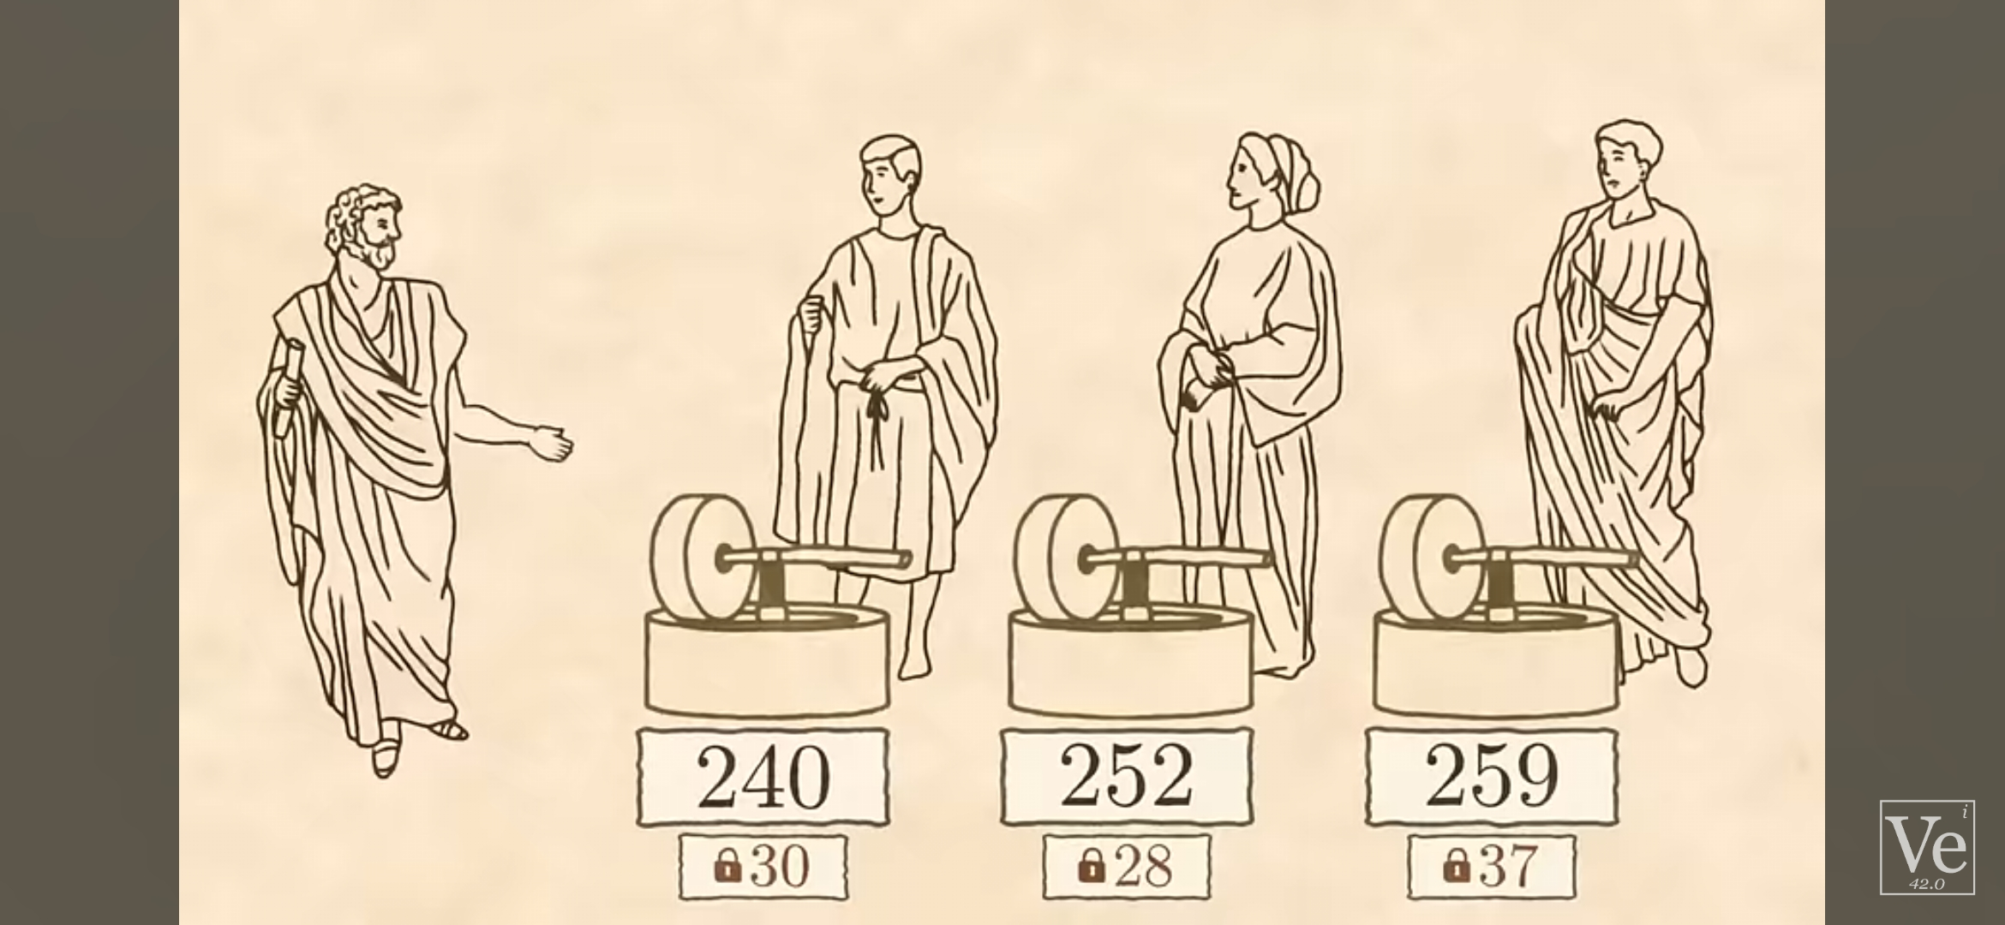

Slide 19


Slide 20
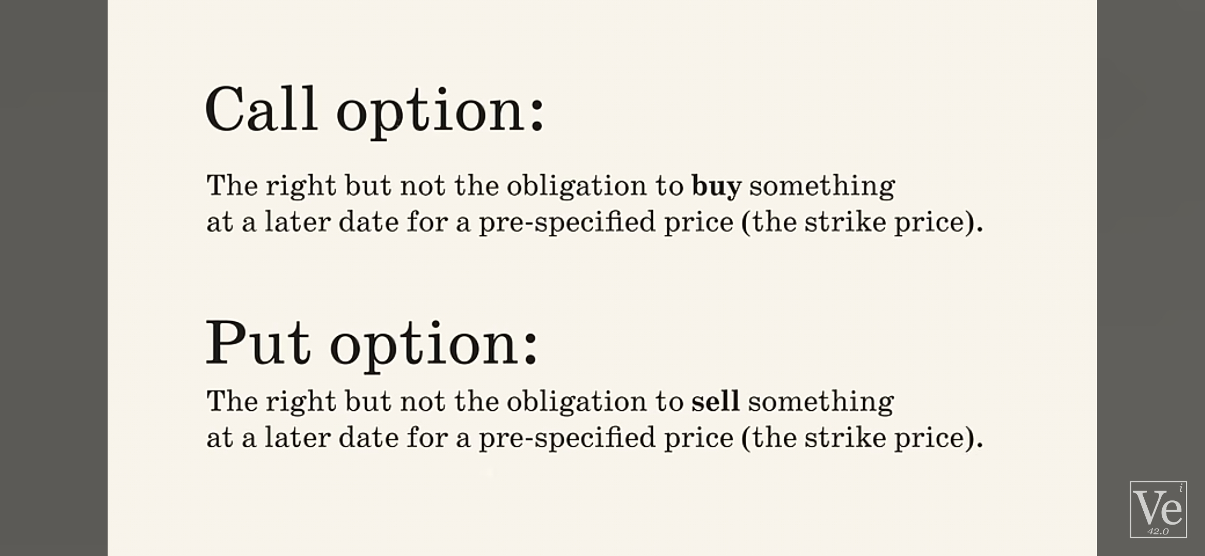

Slide 21
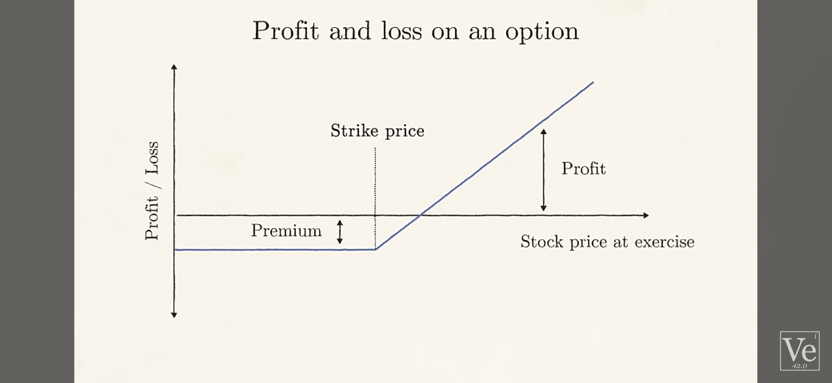

Slide 22
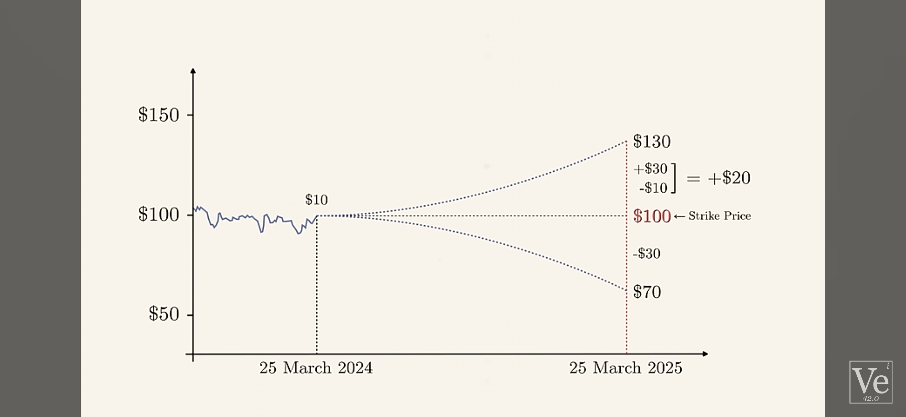

Slide 23
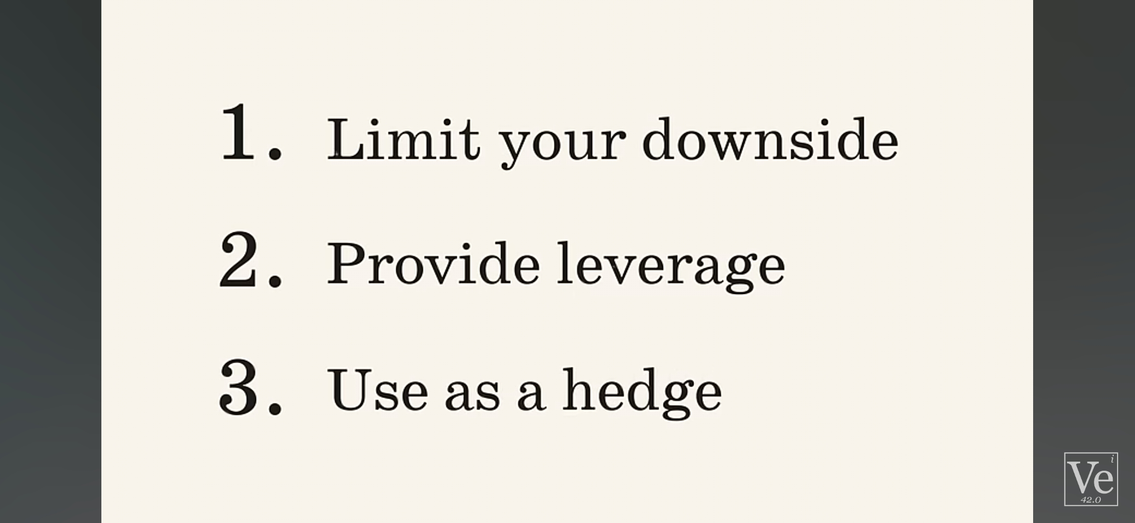

Slide 24
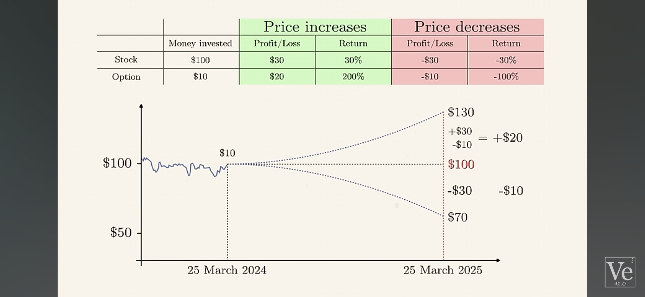

Slide 25
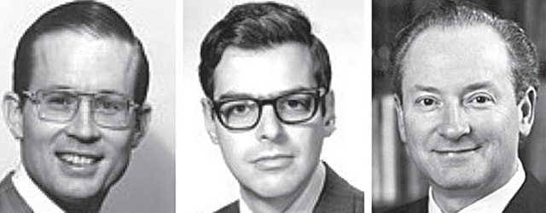
Black Scholes Merton BSOPM
The Black-Scholes formula provides a theoretical framework to value stock options. It considers key factors like underlying asset price, strike price, time to expiration, volatility, and risk-free interest rate. While the model has limitations , it revolutionized options pricing and remains a cornerstone in finance.

Slide 26
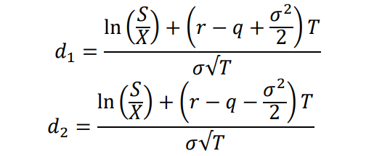
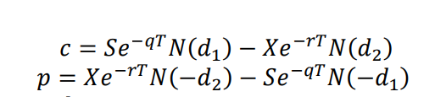
Black-Scholes-Merton Equation
This equation is for European call/put options because , European options hold an expiration date . Its mathematically simpler than American call/put options .
𝐻𝑒𝑟𝑒, 𝑆 = 𝑆𝑡𝑜𝑐𝑘 𝑃𝑟𝑖𝑐𝑒 𝑋 = 𝑆𝑡𝑟𝑖𝑘𝑒 𝑃𝑟𝑖𝑐𝑒 / Exercise Price 𝑟 = 𝑅𝑖𝑠𝑘 𝑓𝑟𝑒𝑒 𝑖𝑛𝑡𝑒𝑟𝑒𝑠𝑡 𝑟𝑎𝑡𝑒 𝑇 = 𝑇𝑖𝑚𝑒 𝑡𝑜 𝑒𝑥𝑝𝑖𝑟𝑎𝑡𝑖𝑜𝑛 𝑖𝑛 𝑦𝑒𝑎𝑟𝑠 𝜎 = Standard deviation of log returns (Volatility) 𝑁(𝑥) = 𝐶𝑢𝑚𝑢𝑙𝑎𝑡𝑖𝑣𝑒 𝑛𝑜𝑟𝑚𝑎𝑙 𝑑𝑖𝑠𝑡𝑟𝑖𝑏𝑢𝑡𝑖𝑜𝑛 𝑓𝑢𝑛𝑐𝑡𝑖𝑜𝑛

Slide 27
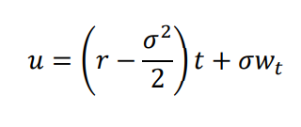
For each day’s stock price, we can write-
𝑇𝑜𝑑𝑎𝑦 ′𝑆𝑡𝑜𝑐𝑘 𝑃𝑟𝑖𝑐𝑒 = 𝑌𝑒𝑠𝑡𝑒𝑟𝑑𝑎𝑦 ′ 𝑠 𝑆𝑡𝑜𝑐𝑘 𝑃𝑟𝑖𝑐𝑒 ∗ 𝑒^u ‘e’ is an exponential term function and ‘u’ is defined to be the periodic daily rate of return e periodic daily rate of return [u] based on BSOPM and the Brownian motion :
The future stock price is,

Slide 28
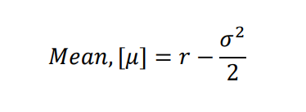
The central limit theorem states that if a large number of random samples of a company are taken from the population and the mean is calculated, the distribution of these sample means assumes the normal probability distribution. This means that if a graph of periodic daily return forms a normal distribution bell-shaped graph, the future periodic rates of return will also be normally distributed, using the Brownian motion in the Black-Scholes formula.

Slide 29
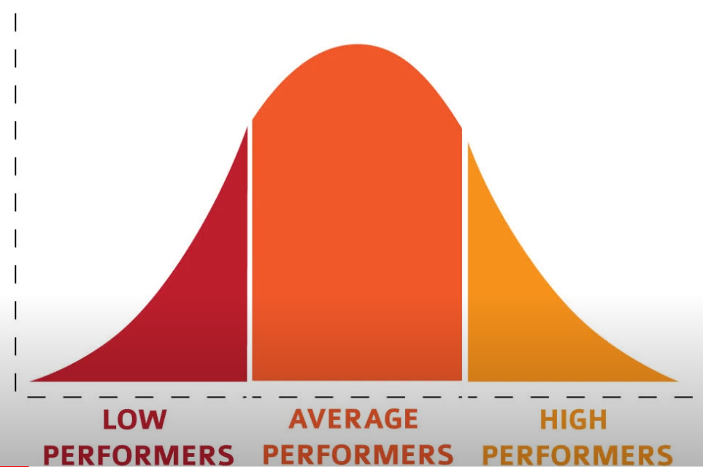
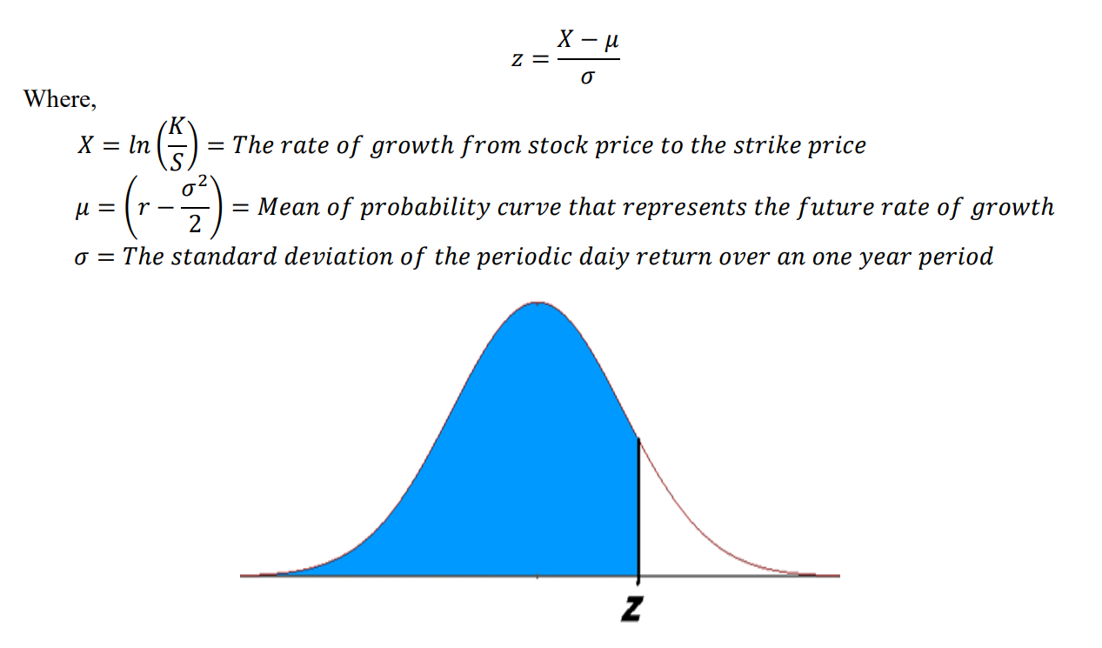
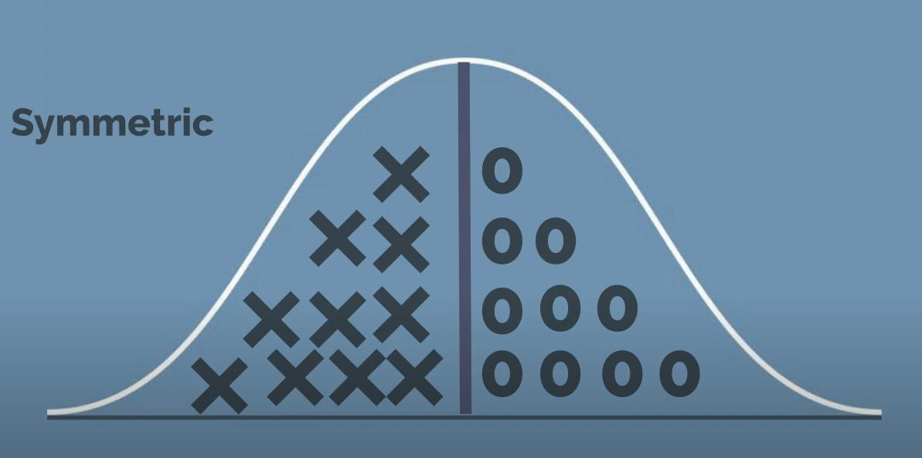
• Use this to determine stock price's probability of above or below strike price of an option. • Determine the rate of growth required for current stock price to reach strike price. • Determine standard deviation from expected rate of growth, known as the standard Z score. • Z score is probability, defined in statistics.
Figure of a probability distribution curve

Slide 30
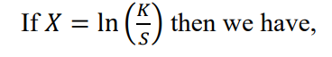
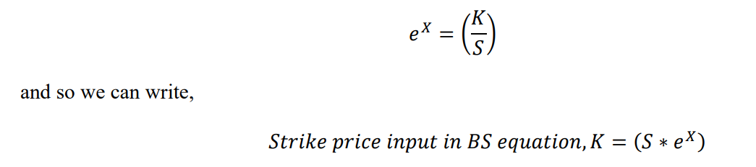
“Strike Price” parameter
• Strike price is the fixed price at which an option owner can buy or sell the underlying security.
To calculate strike price in frontier markets, a mathematical method is used, based on the lognormal distribution.
. K= 𝑇𝑜𝑑𝑎𝑦′𝑠 𝑐𝑙𝑜𝑠𝑒 𝑝𝑟𝑖𝑐e , S= 𝑌𝑒𝑠𝑡𝑒𝑟𝑑𝑎𝑦 ′𝑠 𝑐𝑙𝑜𝑠𝑒 𝑝𝑟𝑖𝑐𝑒

Slide 31
“Time” parameter
Considered date of year and month (in days, counted from January )/ 261 days of trading days in a year Ex : Buyer buy a Stock in June 1st so January to June = 109.75 days 𝑇𝑖𝑚𝑒 𝑖𝑛𝑝𝑢𝑡 𝑖𝑛 𝐵𝑆 𝑒𝑞𝑢𝑎𝑡𝑖𝑜𝑛 = 109.75/261 = 0.4204

Slide 32
‘Volatility’ parameter
• Volatility is a key parameter in derivative markets, directly related to stock price movements. • Increased volatility widens the range of share prices. • Options are non-linear securities traded by traders with volatility information. • Profits are made by exploiting stocks moving at higher margins due to higher volatility, but also high asset price risk. • Volatility types include historical and implied volatility. • Implied volatility comes from the market, matching the Black-Scholes price. • Historical volatility is derived from past market prices, used by traders to trade options.

Slide 33
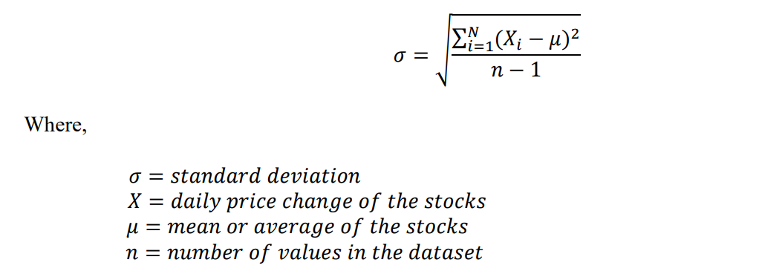
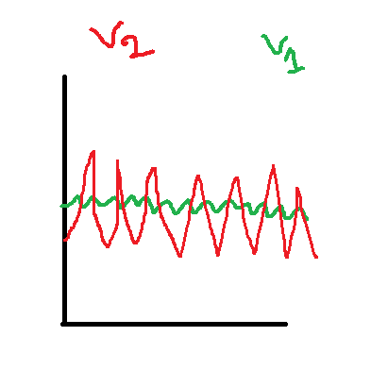
𝜎 = Standard deviation of log returns (Volatility) 𝑉𝑜𝑙𝑎𝑡𝑖𝑙𝑖𝑡𝑦 𝑜𝑓 𝑡ℎ𝑒 𝑟𝑒𝑙𝑎𝑡𝑖𝑣𝑒 𝑝𝑟𝑖𝑐𝑒 𝑐ℎ𝑎𝑛𝑔𝑒 𝑜𝑓 𝑡ℎ𝑒 𝑢𝑛𝑑𝑒𝑟𝑙𝑦𝑖𝑛𝑔 𝑠𝑡𝑜𝑐𝑘 𝑝𝑟𝑖𝑐e . Here stock 1 as a v1 and stock 2 as v2. v2 is more volatile cause it jumps over v1 . If you look at the how dispersed the returns are away from there mean the return have more dispersion , It will have a higher standard daviation . So v1 have higher volatility & v2 have lower volatility . ‘Volatility’ parameter = The 2nd method to get volatility is The method is using MATLAB Simulink

Slide 34
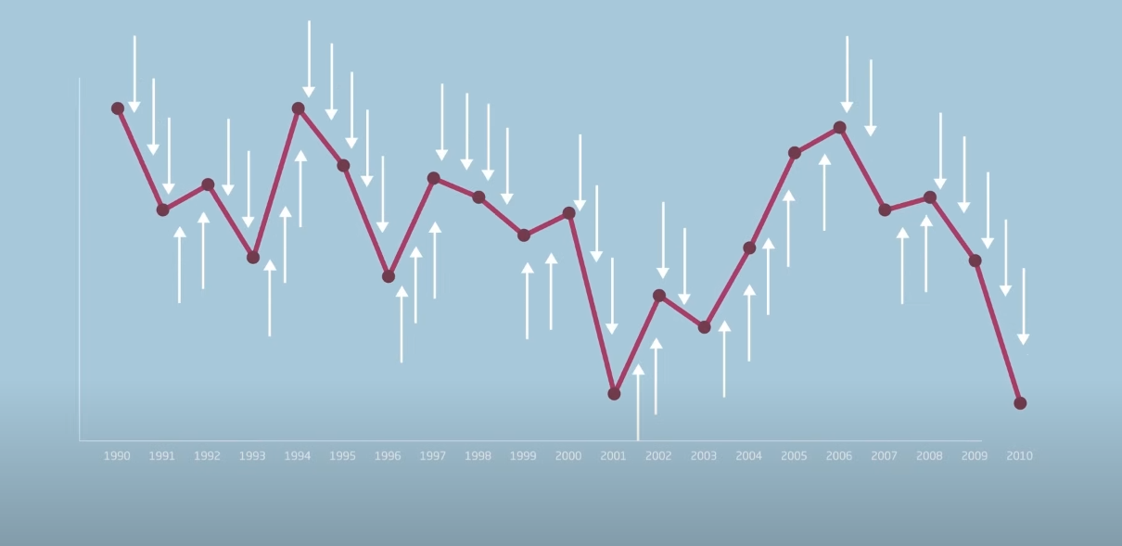

Slide 35
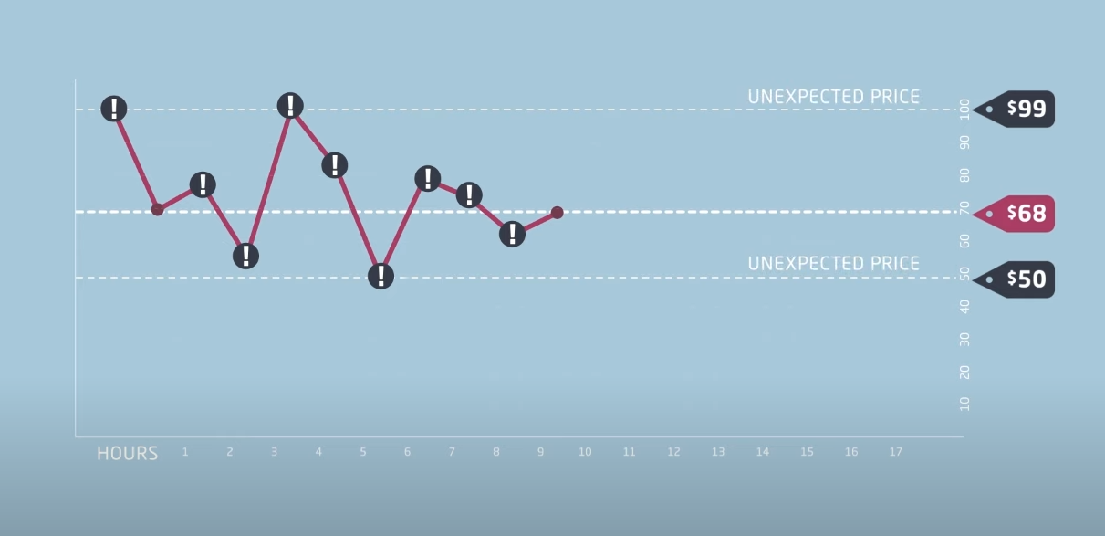

Slide 36
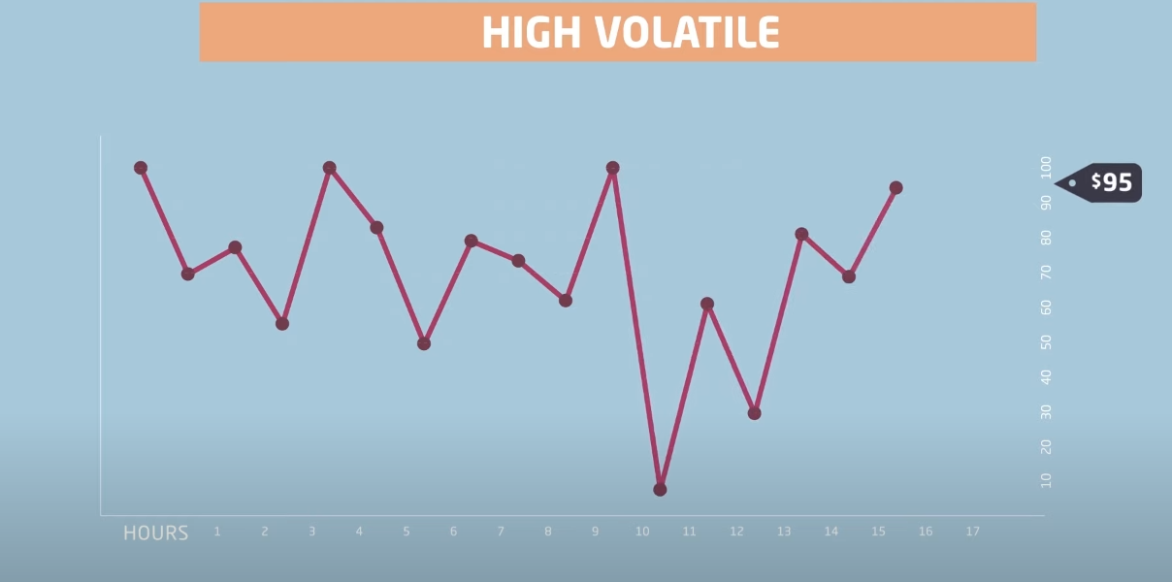

Slide 37
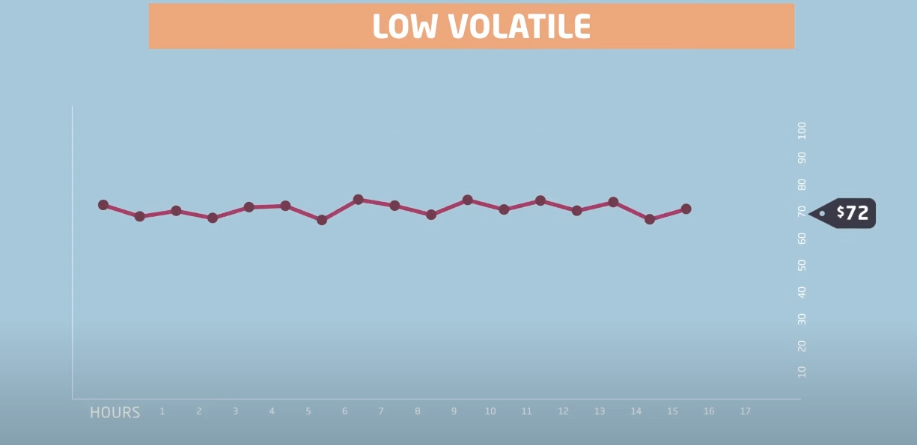

Slide 38
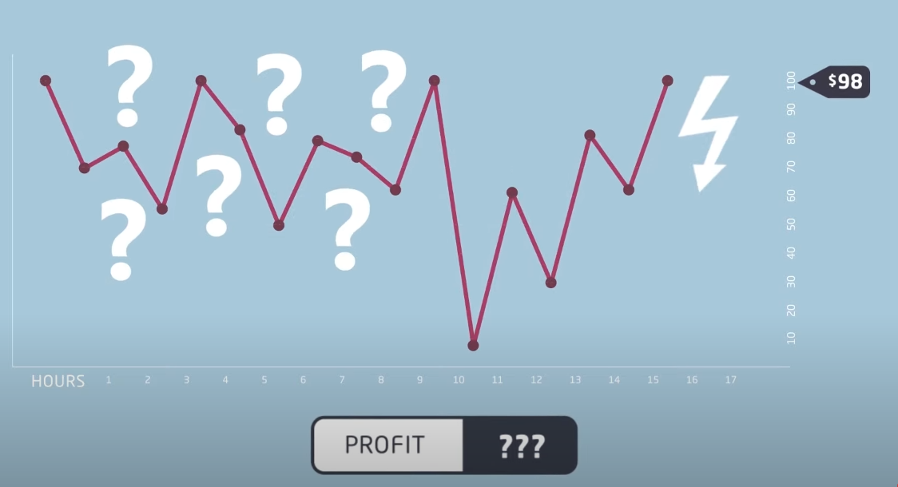

Slide 39
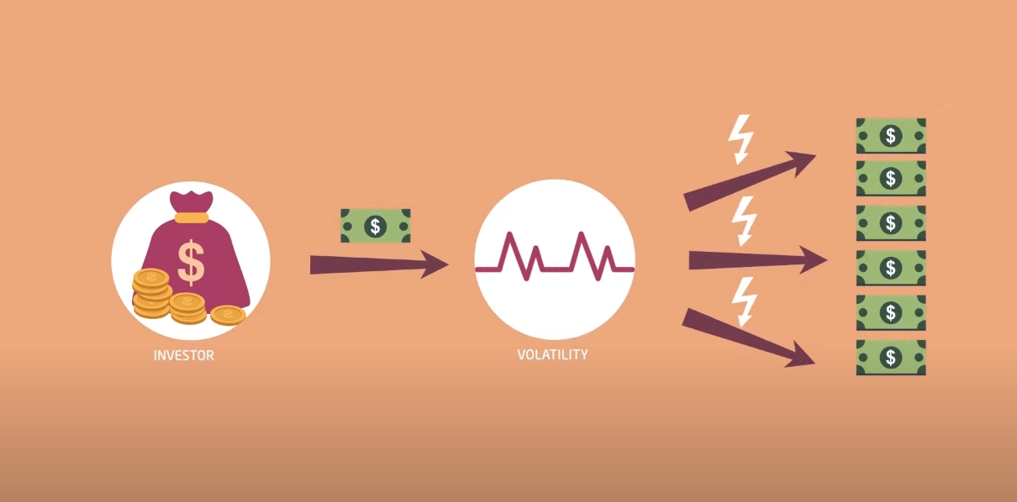

Slide 40


Slide 41
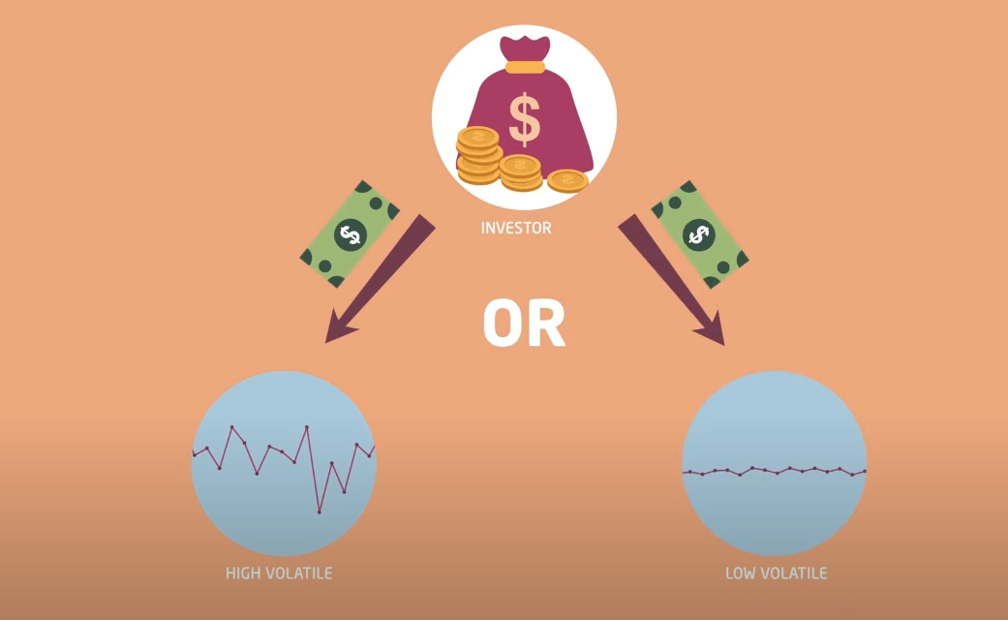

Slide 42
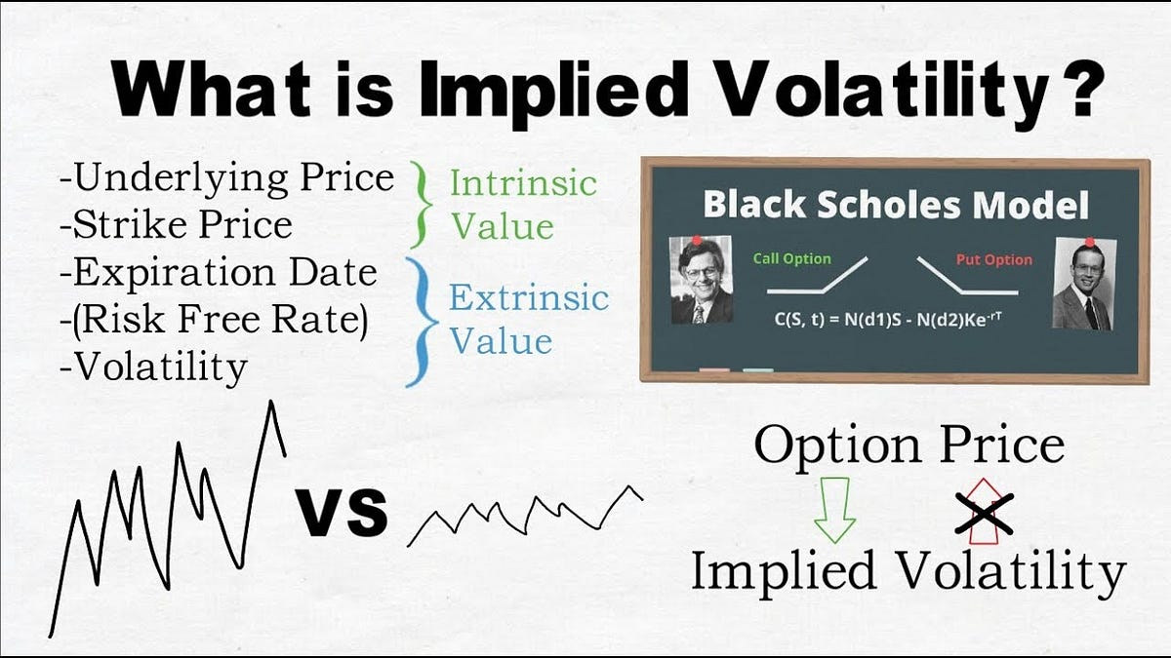

Slide 43
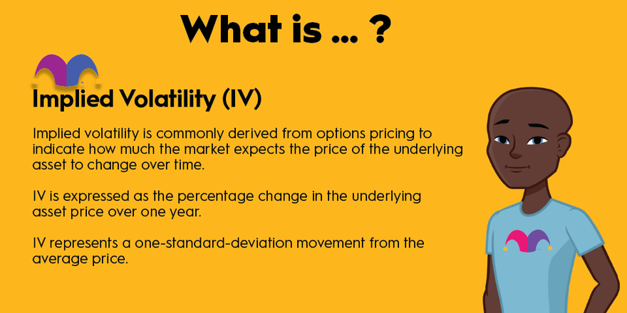

Slide 44
Each option has its own IV IV is dynamic and its value decided by market IV is in % Exchange publishes IV Ex : A option IV increase 19% to 25% than there will be long movement in that specific stock price , If it decrease 19% to 15% now the stock price movement will be small . This is the reason IV is used to predict range of stock .

Slide 45
Stock Price ↓ IV ↑ Whenever option premium increasing IV must be increasing for call option = Spot ↑ IV ↑ & for Put option = Spot ↓ IV↑ (These are for option buyer ) (For seller vice versa)

Slide 46
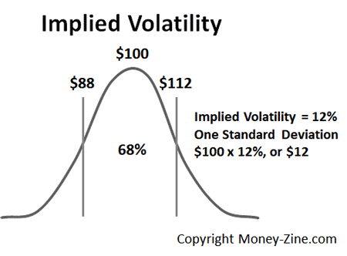
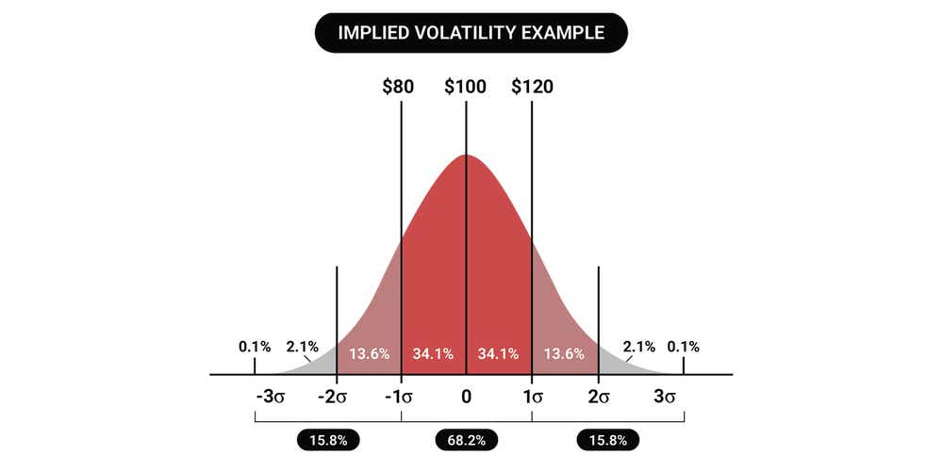

Slide 47
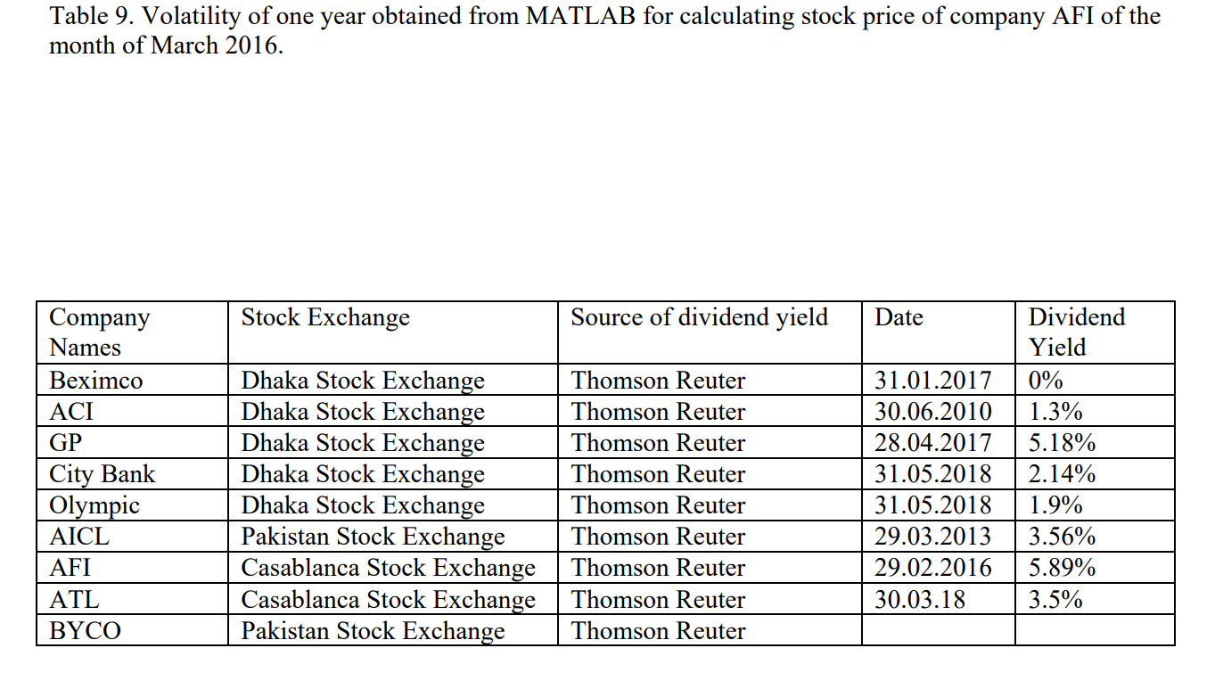
MATLAB Simulink Approach for Stock Volatility Analysis
• Uses MATLAB to provide standard deviation directly in data statistics. • Calculates volatility by comparing the close price of a month and corresponding dates. • Displays min, max, mean, media, mode, standard deviation, and range of prices in data statistics. • Calculates volatility for each month over a year. • Combines the volatility of twelve months of one year for the Black-Scholes equation.

Slide 48

Dividend Yield

Slide 49
Dividend Yield
In our study, we utilized the Black-Scholes-Merton equation to determine the theoretical close price of stocks based on historical data.
We observed that as dividend yield increases, the theoretical close price decreases relative to the actual close price.

Slide 50
Dividend Yield

Slide 51
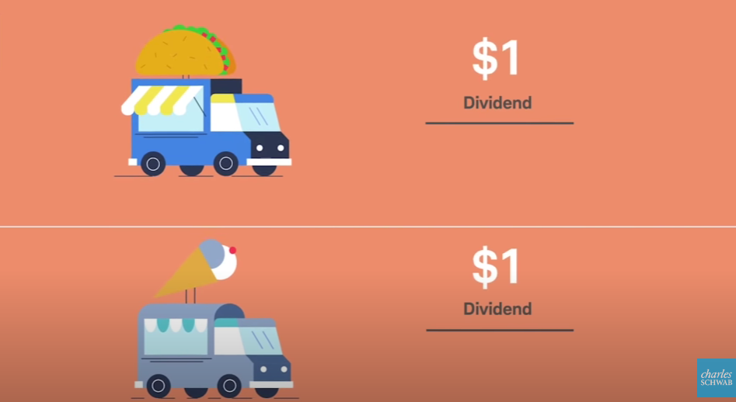

Slide 52
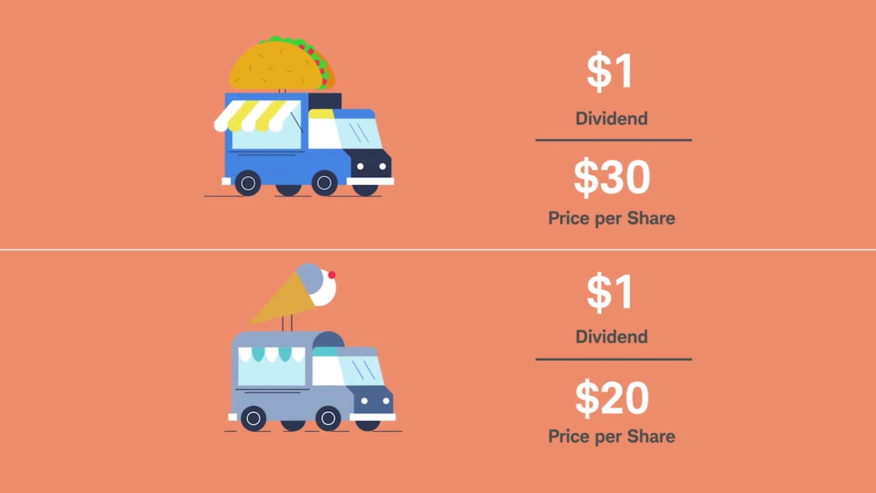

Slide 53


Slide 54
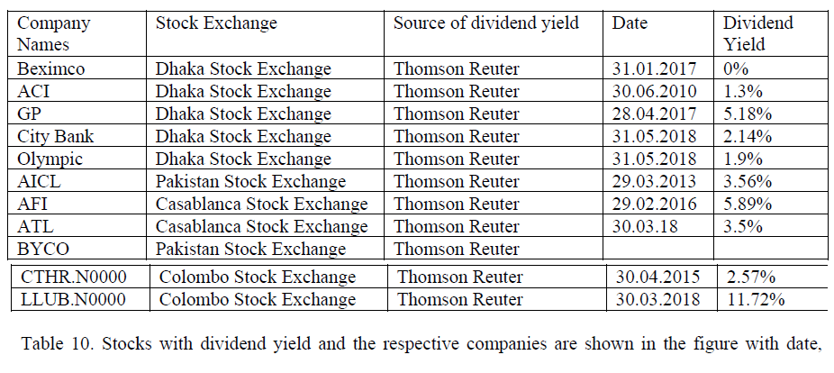

Slide 55
Risk Free Interest Rate
In reality there is no term called risk free interest rate but the Black-Scholes-Merton PDE assumes that the short term interest rate is known and constant through time.
We have collected all data using Thomson Reuters software considering the treasury bills to be the risk free interest rates for all companies given by their corresponding central banks of the respective countries, table is given below .

Slide 56
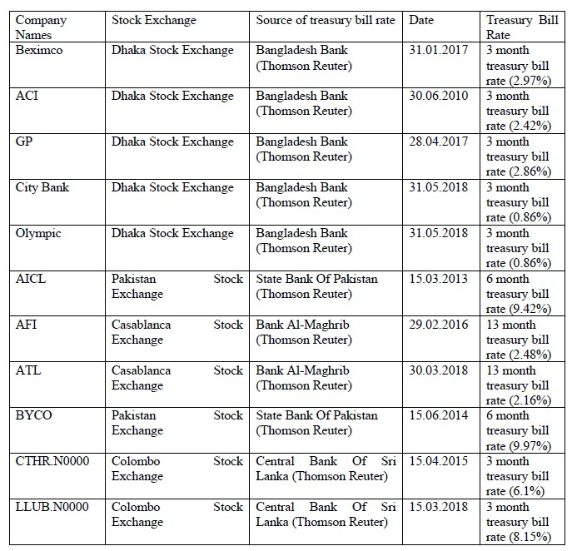
Risk Free Interest Rate

Slide 57
European and American Stock Market
In the case of European options, the holder has the right to exercise the option only at the expiration date. This means they can only exercise their option at a single point in time, namely, at the expiration date.
American options, which allow the holder to exercise at any time before or on the expiration date, European options provide less flexibility in terms of timing.

Slide 58
Modify BSOPM
In order to predict the stock prices of frontier markets using Black-Scholes option pricing model, we have developed an approach by simply changing and modifying the parameters are
1. strike price
2. time of maturity
3. volatility
As in frontier markets trading goes on continuously so we have followed the “American option” trading method, where options can be exercised at any period of time and so it is more compatible for predicting the stock price of frontier markets.

Slide 59
Modify BSOPM
One of the interesting findings of this research is related to the parameter “volatility” of Black-Scholes equation. It has been found that, the market crash is related directly with the sudden huge increase in volatility of the stocks.
If the volatility increases continuously, month by month along with the increase in the stock price of companies of a frontier market like Dhaka stock exchange at a tremendous rate, then it has to be understood that, the market is likely to get crashed or fall in near future.
It is because the volatility can not remain high for a long period of time due to overpricing as people do not trade stocks in the same way everyday and so there have to be some increment and decrement in the prices of the stocks in the market.

Slide 60
Modify BSOPM
To observe the increase and decrease of volatility, we have used MATLAB.
It is because the software takes into account the close price (stock price) of the stock of a particular company of a frontier market for calculating the volatility and displays the volatility based on this close price of the stock with the corresponding date on which the stock was traded and hence, it becomes easier for a trader to see the change in volatility of the stock.

Slide 61
Using matching learning
In order to verify the results obtained using Black- Scholes equations, we have used data mining and machine learning techniques in Rapidminer, where we have used some algorithms and methods like decision tree, neural net, linear regression and ensemble learning method to predict the future stock prices of eleven companies of different stock exchanges of frontier markets.
The changes and modifications made to the Black-Scholes equations have also been explained from the point of view of quantum physics based on the analogy of Schrodinger equation.

Slide 62
Decision Tree
The decision tree algorithm is a crucial tool for stock price prediction, capable of both classification and regression tasks. It partitions data to minimize error, making it effective for predicting close prices.
In our study, we utilized Rapidminer to generate decision tree models, dividing the dataset into training and testing subsets.
Parameter tuning, including criterion selection, depth adjustment, and minimal gain, aimed to enhance prediction accuracy.
Performance evaluation using the performance operator yielded statistical criteria for regression tasks.

Slide 63
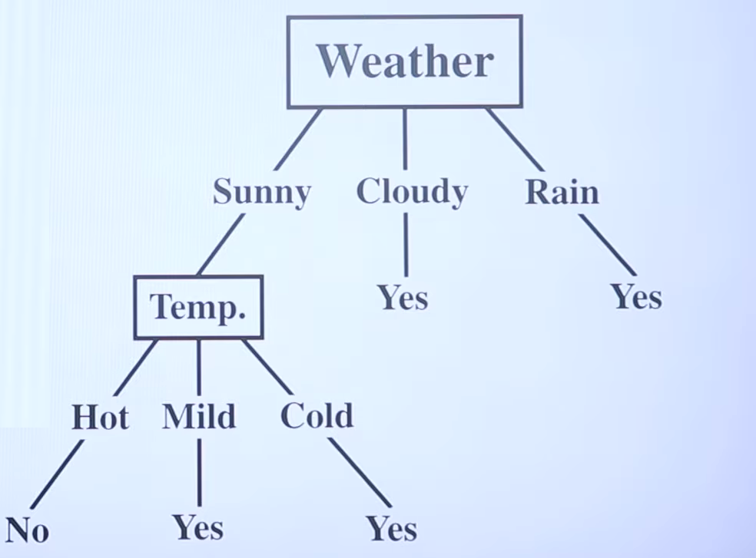

Slide 64
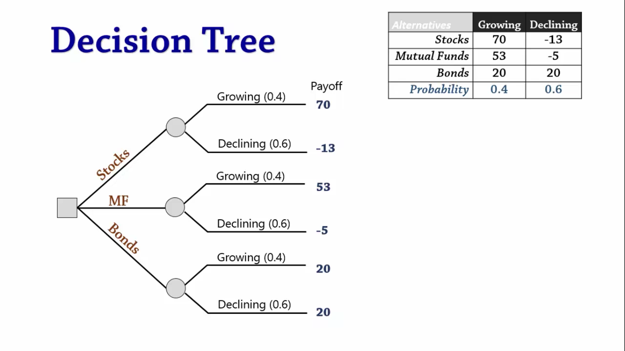

Slide 65
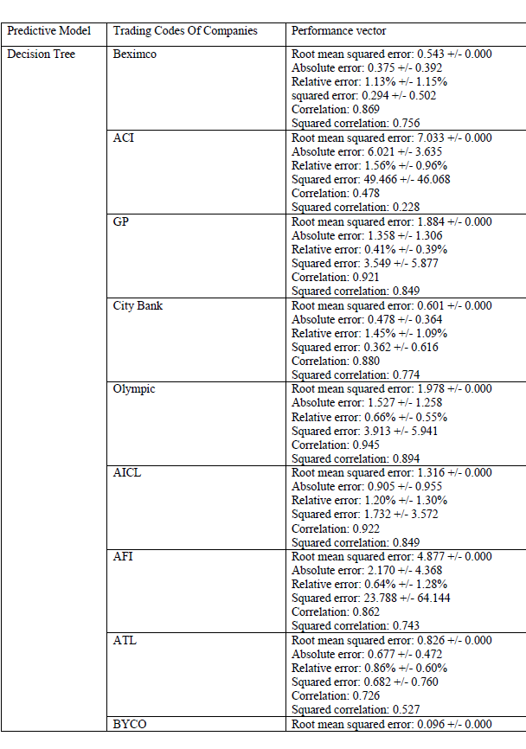

Slide 66
Comparison between original and predicted close price obtained from Rapidminer using decision tree model (a) for the month February 2017 of company Beximco (b) for the month October 2010 of company ACI. (c) for the month May 2017 of company GP. (d) for the month June 2018 of company City Bank. (e) for the month June 2018 of company Olympic. (f) for the month April 2013 of company AICL. (g) for the month March 2016 of company AFI. (h) for the month April 2018 of company ATL. (i) for the month July 2014 of company BYCO.

Slide 67
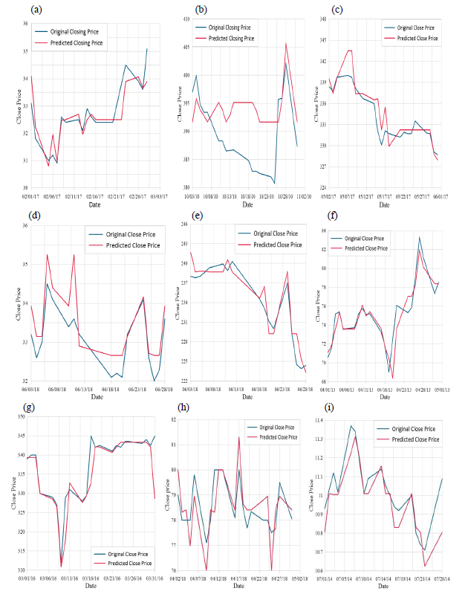

Slide 68


Slide 69
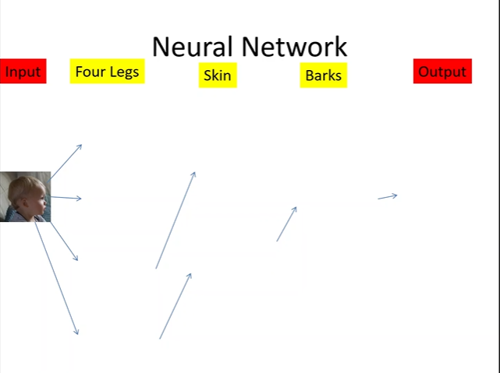

Slide 70
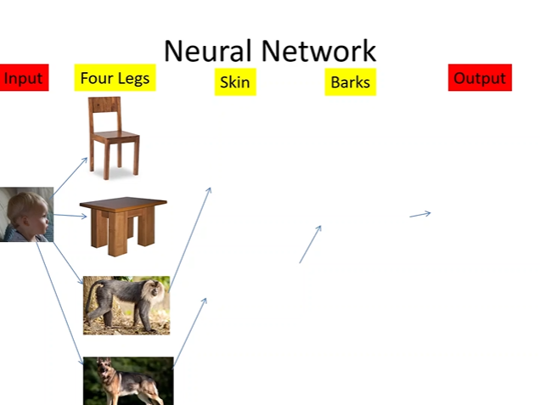

Slide 71
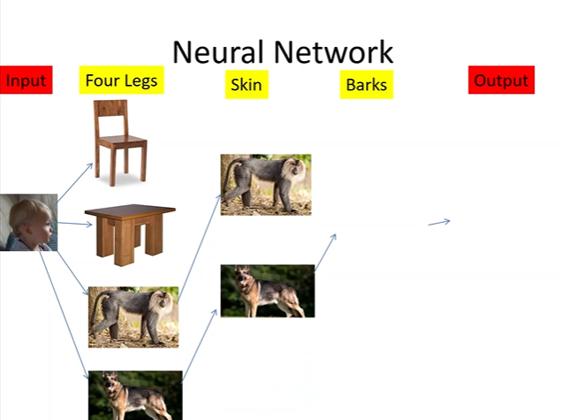

Slide 72
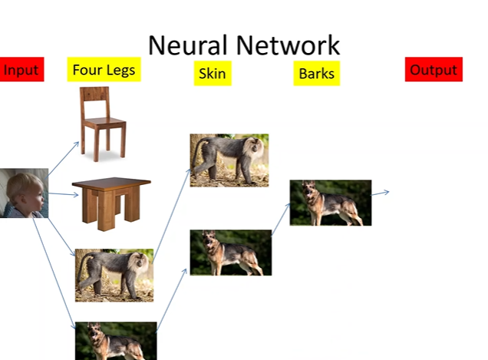

Slide 73
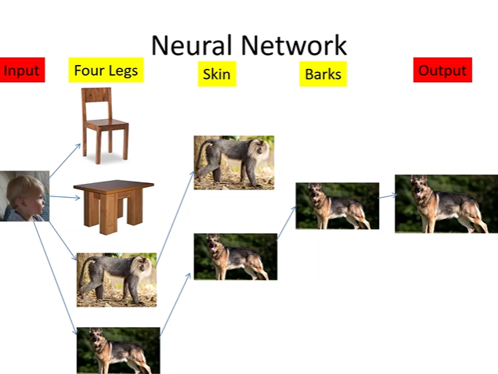

Slide 74
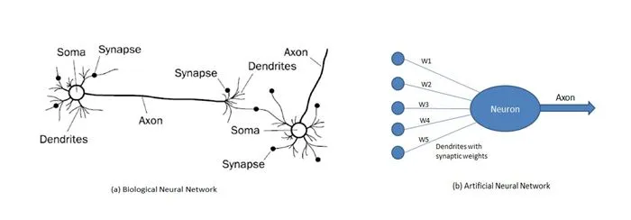

Slide 75
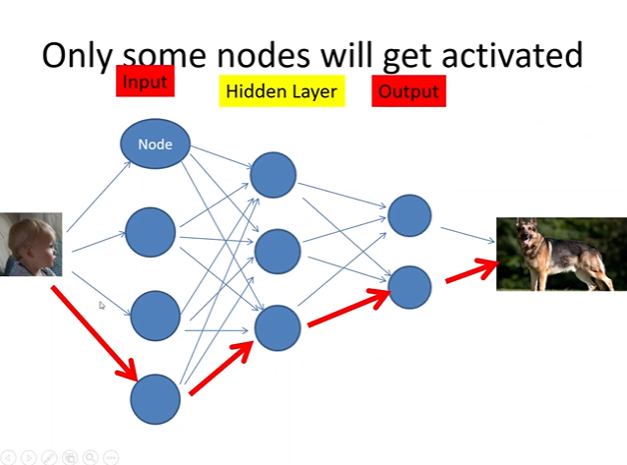

Slide 76


Slide 77


Slide 78


Slide 79


Slide 80


Slide 81


Slide 82


Slide 83

What's a Neural Network?
Think of a neural network as a computer system that's designed to work like our brains. It's made up of interconnected parts called neurons, which help process information.

Slide 84

Using RapidMiner:
RapidMiner is a tool that helps us build and analyze neural network models. It makes it easier for us to work with complex data and algorithms.

Slide 85

Datasets:
We have data divided into two parts: training and testing sets. These contain information about stock prices for different companies.

Slide 86

Training the Model:
We use historical stock prices from the training set to teach the neural network how to make predictions. This is like showing it examples of past data so it can learn from them.

Slide 87

Testing Phase:
Once the model is trained, we test it using new data from the testing set. This helps us see how well the model can predict stock prices for a specific month.

Slide 88

Data Preparation:
Before training and testing, we need to prepare the data. We use operations like "set role" to assign roles to different attributes and "windowing" to organize the data properly.

Slide 89

Training Process:
During training, the neural network adjusts its internal parameters to minimize the difference between predicted and actual stock prices. We set parameters like the number of training cycles and learning rate to help it learn effectively.

Slide 90

Testing Performance:
In the testing phase, we evaluate how well the model performs using metrics like accuracy. This helps us understand if the predictions are close to the actual stock prices.

Slide 91
Visualizing Results:
To see how well the model did, we use charts and tables to compare the predicted stock prices with the actual ones. This gives us a clear picture of the model's performance.

Slide 92

Conclusion:
Overall, we're using RapidMiner and neural networks to analyze stock prices and make predictions. By training the model with historical data and testing it with new data, we can make informed decisions about investments.

Slide 93


Slide 94


Slide 95


Slide 96


Slide 97


Slide 98


Slide 99


Slide 100


Slide 102


Slide 103
Graph

Slide 104
Comparison between original and predicted close price obtained from Rapidminer using neural net model (a) for the month February 2017 of company Beximco. (b) for the month October 2010 of company ACI. (c) for the month May 2017 of company GP. (d) for the month June 2018 of company City Bank. (e) for the month June 2018 of company Olympic. (f) for the month April 2013 of company AICL. (g) for the month March 2016 of company AFI. (h) for the month April 2018 of company ATL. (i) for the month July 2014 of company BYCO.

Slide 105


Slide 106
Comparison between original and predicted close price obtained from Rapidminer using ensemble learning method (a) for the month February 2017 of company Beximco. (b) for the month October 2010 of company ACI. (c) for the month May 2017 of company GP. (d) for the month June 2018 of company City Bank. (e) for the month June 2018 of company Olympic. (f) for the month April 2013 of company AICL. (g) for the month March 2016 of company AFI. (h) for the month April 2018 of company ATL. (i) for the month July 2014 of company BYCO.

Slide 107


Slide 108
Comparison between original close price and predicted close price by BSOPM and Rapidminer (a) of company Beximco of the month February 2017. (b) of company ACI of the month October 2010. (c) of company GP of the month May 2107. (d) of company City Bank of the month June 2018. (e) of company Olympic of the month June 2018. (f) of company AICL of the month April 2013. (g) of company AFI of the month March 2016. (h) of company ATL of the month April 2018. (i) of company BYCO of the month July 2014.

Slide 109


Slide 110
Comparison between original close price and predicted close price using Black-Scholes equations (a) of company Beximco of the month February 2017 depending on January 2017. (b) of company ACI of the month October 2010 depending on June 2010. (c) of company GP of the month May 2107 depending on April 2017. (d) of the month June 2018 depending on May 2108. (e) of company Olympic of the month June 2018 depending on May 2018. (f) of the month April 2013 depending on March 2103. (g) of company AFI of the month March 2016 depending on February 2016. (h) of company ATL of the month April 2018 depending on March 2018.

Slide 111


Slide 112
Colclusion
Our approach utilizes the Black-Scholes equations to predict stock prices in frontier markets, offering valuable insights into strike price, volatility, and time of expiration.
By adjusting parameters accordingly, such as using historical stock prices to forecast future prices, traders can anticipate market trends and potentially maximize profit.
The method is continuous, with predictions based on evolving market data.
Both our approach and traditional data mining methods yield similar results, suggesting the efficacy of Black-Scholes in frontier market analysis.

Slide 113
Thank You

